Slide 1
Linear Regression with ecommerce data
By: Keside Unegbu

Slide 2
Agenda
01 | Data imports and exploration
02 | Exploratory Data analysis
03 | Feature selection and splitting
04 | Model training
05 | Evaluation

Slide 3
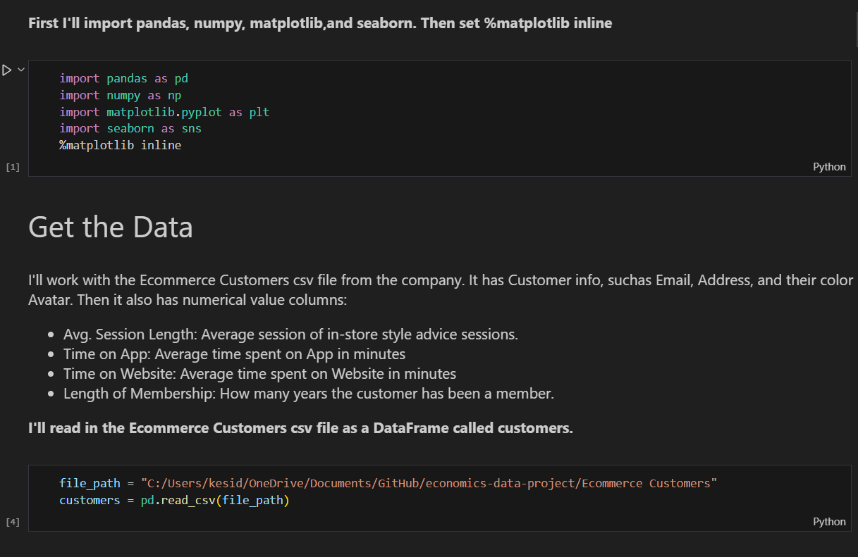
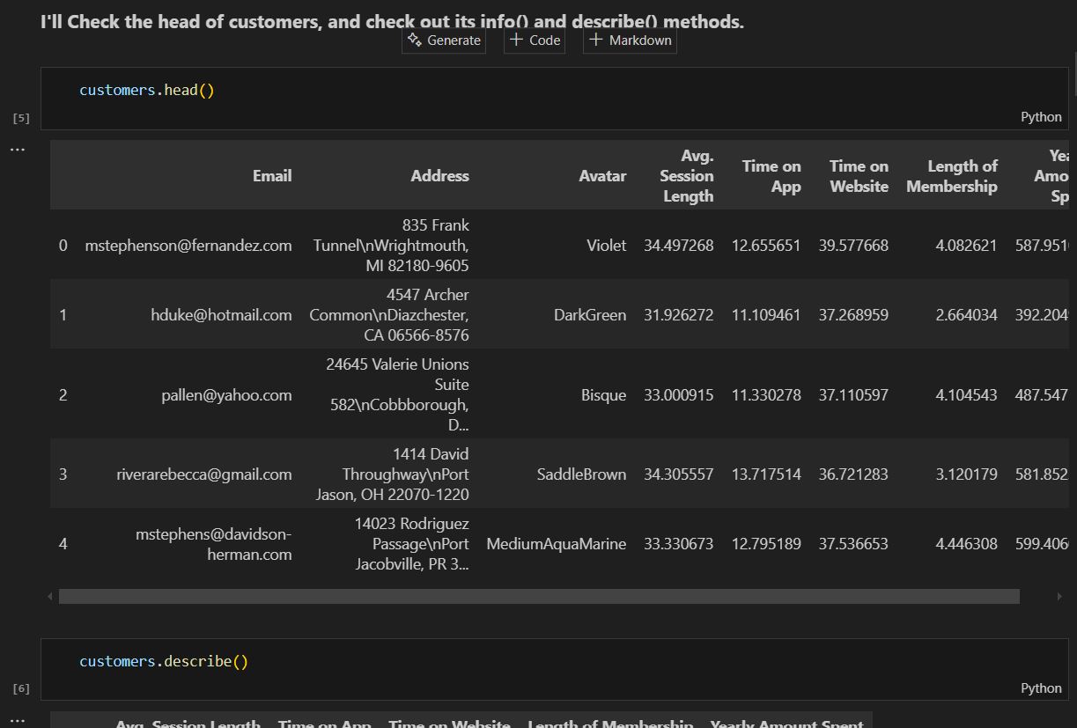
Data imports and exploration
I import all the libraries I need to do data analysis and visualization.
I also used the head() method to bring me the first 5 rows of the data set

